Slide 1

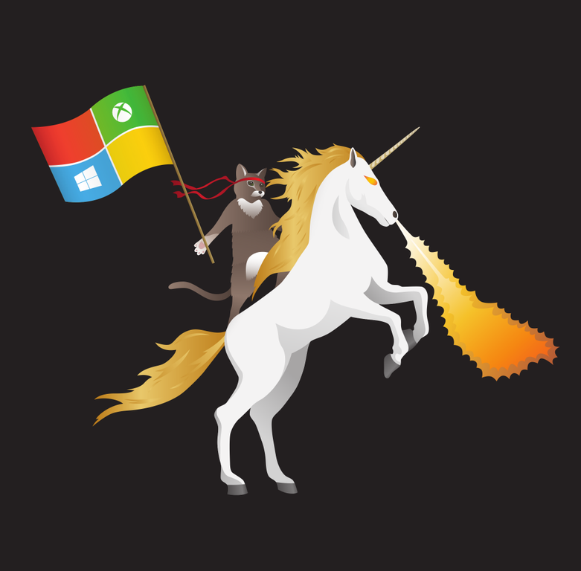
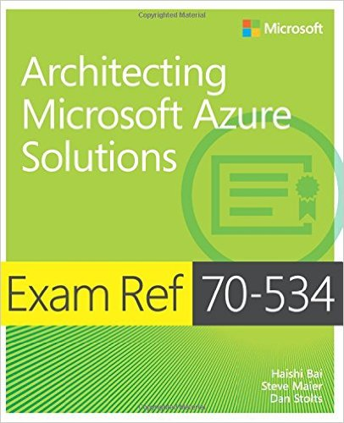



Containers +++
Dan Stolts (@ITProGuru) Chief Technology Strategist US DX North East – Audience Blog: ITProGuru.com
dstolts@Microsoft.com
www.linkedin.com/in/danstolts
Specializations:
Cloud, Virtualization, Windows Server
Open Systems, Hybrid Cloud, Storage
aka.ms/70-534-book
@ITProGuru
Notes:
Linux, Windows Server and Hyper-V Containers: What They Are, Which One to Use, Why and How, plus Integration with Azure Private/Public/Hybrid Cloud, with Microsoft A container is an isolated and portable operating environment. It provides a mechanism for IT to deploy services in a portable, repeatable and predictable manner. Container technology is the next evolution in virtualization, and in addition to Linux, Windows now also offers two different types of containers for addressing various business needs. In this session Dan Stolts, world renown Technical Evangelist at Microsoft and a dynamic/engaging presenter, will examine the similarities and differences between a container and a virtual machine, review the requirements and walk through the processes and essential operations of enabling, creating, deploying and managing Linux and Windows containers and resources. Mr. Stolts will also evaluate when to use which containers, why and how? For those who are new to containers, his delivery serves as a jumpstart to accelerate your learning of containers. If you have already had some experience on Linux containers, his session familiarizes you with the specifics on Windows containers and helps bridge and extend your skills for bringing business value to both Linux and Windows communities. Mr. Stolts will conclude this session by highlighting the top five new features in Microsoft's Azure cloud platform for 2017, and how to integrate your organization's public/private/hybrid cloud and container strategies. Lots of valuable content for infrastructure, data center and DevOps professionals.
Name of Presenter: Dan Stolts
Bio of Presenter (max 500 spaces): Dan Stolts “ITProGuru” is a technology expert who is a master of systems management and security. He is Chief Technology Strategist for Microsoft, owns several businesses and is a published author. Reach him on his primary blog http://itproguru.com or twitter @ITProGuru. He is proficient in many datacenter technologies (Windows Server, System Center, Virtualization, Cloud, Etc) and holds many certifications including MCT, MCITP, MCSE, TS, etc. Dan is currently specializing in system management, virtualization and cloud technologies. Dan is and has been a very active member of the user group community. Dan is an enthusiastic advocate of technology and is passionate about helping others. See more at: http://itproguru.com/about

Slide 2
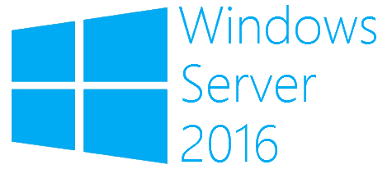
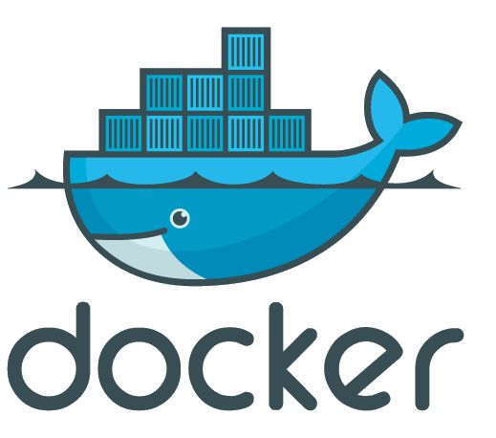
What is a container?
Containers
Windows Server containers Maximum speed and density
= Operating system virtualization
OS
Container
Container
Container
Applications
Container
Container
Container
Kernel
OS
Hardware
Kernel
Traditional virtual machines = hardware virtualization
Hyper-V containers Isolation plus performance
Application
VM
VM
VM
Container
Container
Container
OS
Hardware
Kernel
Kernel
Kernel
Hyper-V

Slide 3
What is a container?
Package distribution mechanism – Shout out to acr here
MyApp.v2
MyApp.v2
Laptop/Dev Image Here
Azure Container Registry
Push
Pull

Slide 4
What is a container?
A clear boundary for your stuff
Operating
System
Web Server
Monitoring Agent
Log Roller
SSH Daemon

Slide 5
What is a container?
A clear boundary for your stuff
Operating
System
Web Server
Log Roller
SSH Daemon
Monitoring Agent

Slide 6
What is a container?
Runtime isolation
Production Web Server
Intern’s Minecraft Server

Slide 7








Session VS VM (or VDI)
OS, Apps, Config, Mgmt
EACH Workload
Single OS
All Workloads
OS
OS
OS
OS
Apps
Apps
Apps
Apps
Massive VM Overhead
(Disk, Disk IO, Memory, CPU, OS, Licenses, Density, The works)
OS
OS
OS
OS
Apps
Apps
Apps
Apps
OS
OS
OS
OS
workloads
Apps
Apps
Apps
Apps
OS
OS
OS
OS
Apps
Apps
Apps
Apps
Application(s)
Application(s)
Operating
System
Operating
System
Parent OS
Hardware Virtualization
Hardware Virtualization
Hardware / Hypervisor Level
Session Based Computing
VM or VDI Based Computing

Slide 8
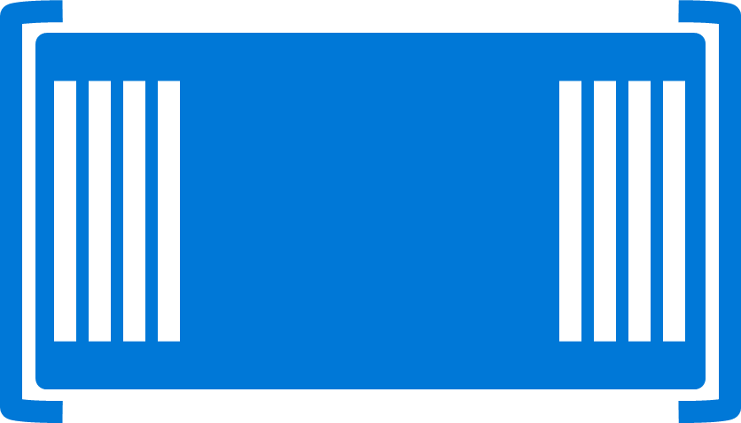

Containers
Single OS
All Workloads
OS
EACH Platform
App
App
App
App
App
App
App
App
App
App
App
App
App
App
App
App
App
App
App
App
App
App
App
App
All Advantages of VM & Session
Isolation, Little overhead
workloads
App
App
App
App
App
App
App
App
Container / Image
App
App
App
App
Container Engine
App
App
Linux VM
Container / Image
Container
Container
Application(s)
Container Engine
Container Engine
Operating
System
Operating
System
Parent OS
Hardware Virtualization
Hardware Virtualization
Hardware / Hypervisor Level
Container Based Density Advantages
Container Based Computing VM Isolation

Slide 9
Containers Deep Dive: Architecture of a Host
App
App
App
App
App
App
App
App
App
App
Copy on Write
Any layer that is SAVED or Downloaded is locked
Any workload
New Blank is created to allow write
Container Engine
Engine and Orchestration are different jobs, not always different products
Any workload can be set as a BASE by saving
It can then be used as a base, All required pieces below it will automatically be deployed
App
App
App
App
App
Web Sites
Web Site
Web App
App
App
Container Orchestration
Web Engine Config
IIS Config
Web Engine Config
Web Engine Base (IIS installed)
OS Base (eg. Nano)
Container Engine (Windows, Linux, Docker)
Operating
System
Hardware Virtualization

Slide 10



How Containers Run
Hyper-V Containers
on VM
Windows Server Containers on VM
Docker Containers
Windows Server Containers
Azure Containers
ACS … Containers As A Service
Virtual Machines
Linux OR Windows
Hyper-V Containers
Hyper-V Hypervisor
Docker Engine
Container Service
Container Service
VM
Linux
OS
Hyper-V Hypervisor
Windows Containers can run on Windows 10 and Nano too!
Azure
Abstracts VM
Windows Host

Slide 11






DevOps: the three stage conversation
DEV
DEV
OPS
OPS
2
2
Process
Process
3
3
Products
1
Tools
1
People
People
“Deliver a Product that Inspires Users to become raving fans”
Notes:
People = Culture
Fundamental attributes of successful cultures:
Shared mission and incentives: infrastructure as code, apps as services, DevOps/all as teams
You need to consider your hardware as a commodity, (don't give your servers names) , servers are like farm animals, it is just harder if you let theids name them
Build deep instrumentation into services, push complexity up the stack
Rally around agile, shared metrics, CI, service owners on call, etc.
Changing the culture: any change takes time, changing culture is no exception and you can't do it alone, exploit compelling events to change culture: downtimes, cloud adoption, devops buzz
PROCESS Definition and design, compliance, and continuous improvement
PEOPLE Responsibilities, management, skills development, and discipline
Products Tools and infrastructure

Slide 12
DevOps Practices
Primary
Secondary
Infrastructure as Code (IaC)
Continuous Integration
Automated Testing
Continuous Deployment
Release Management
App Performance Monitoring
Load Testing & Auto-Scale
Availability Monitoring
Change/Configuration Management
Feature Flags
Automated Environment De-Provisioning
Self Service Environments
Automated Recovery (Rollback & Roll-Forward)
Hypothesis Driven Development
Testing in Production
Fault Injection
Usage Monitoring/User Telemetry
http://www.itproguy.com/devops-practices/

Slide 13
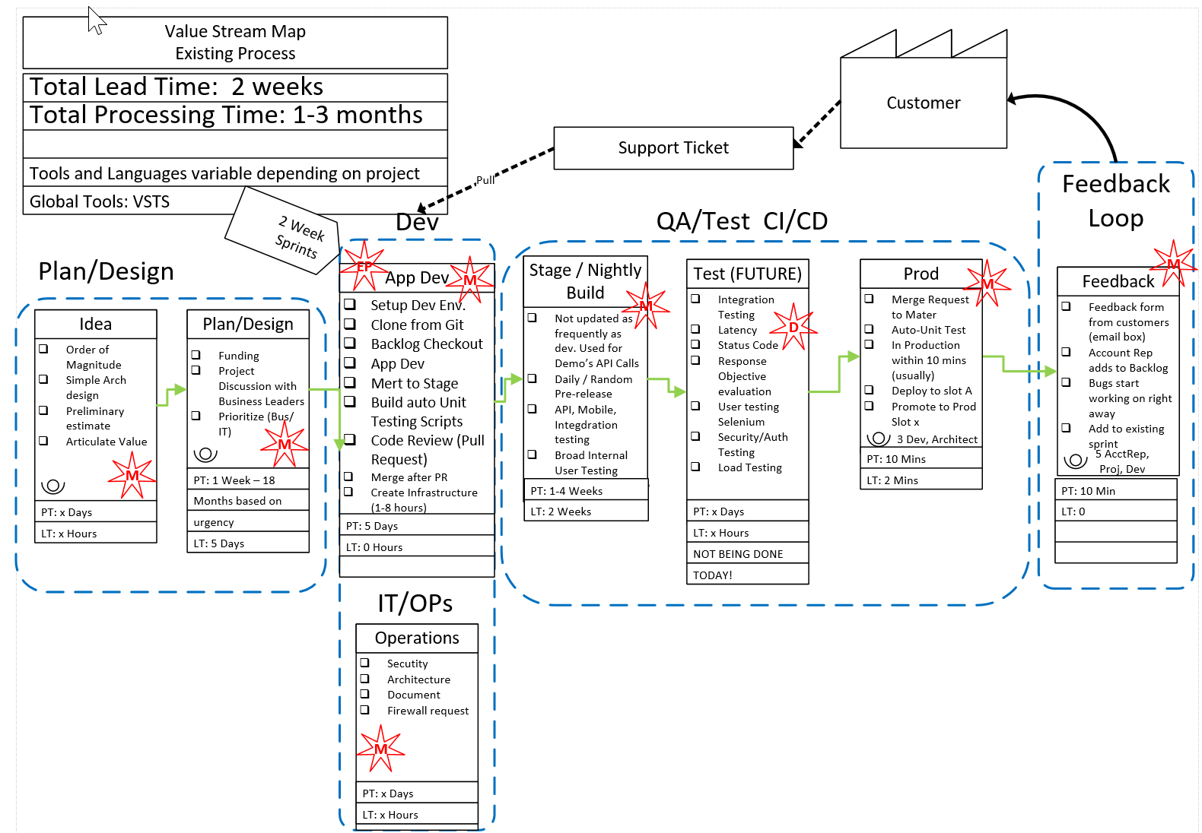
Before DevOps
2 Week Lead time
1-3 Months Processing
Waste in every step

Slide 14
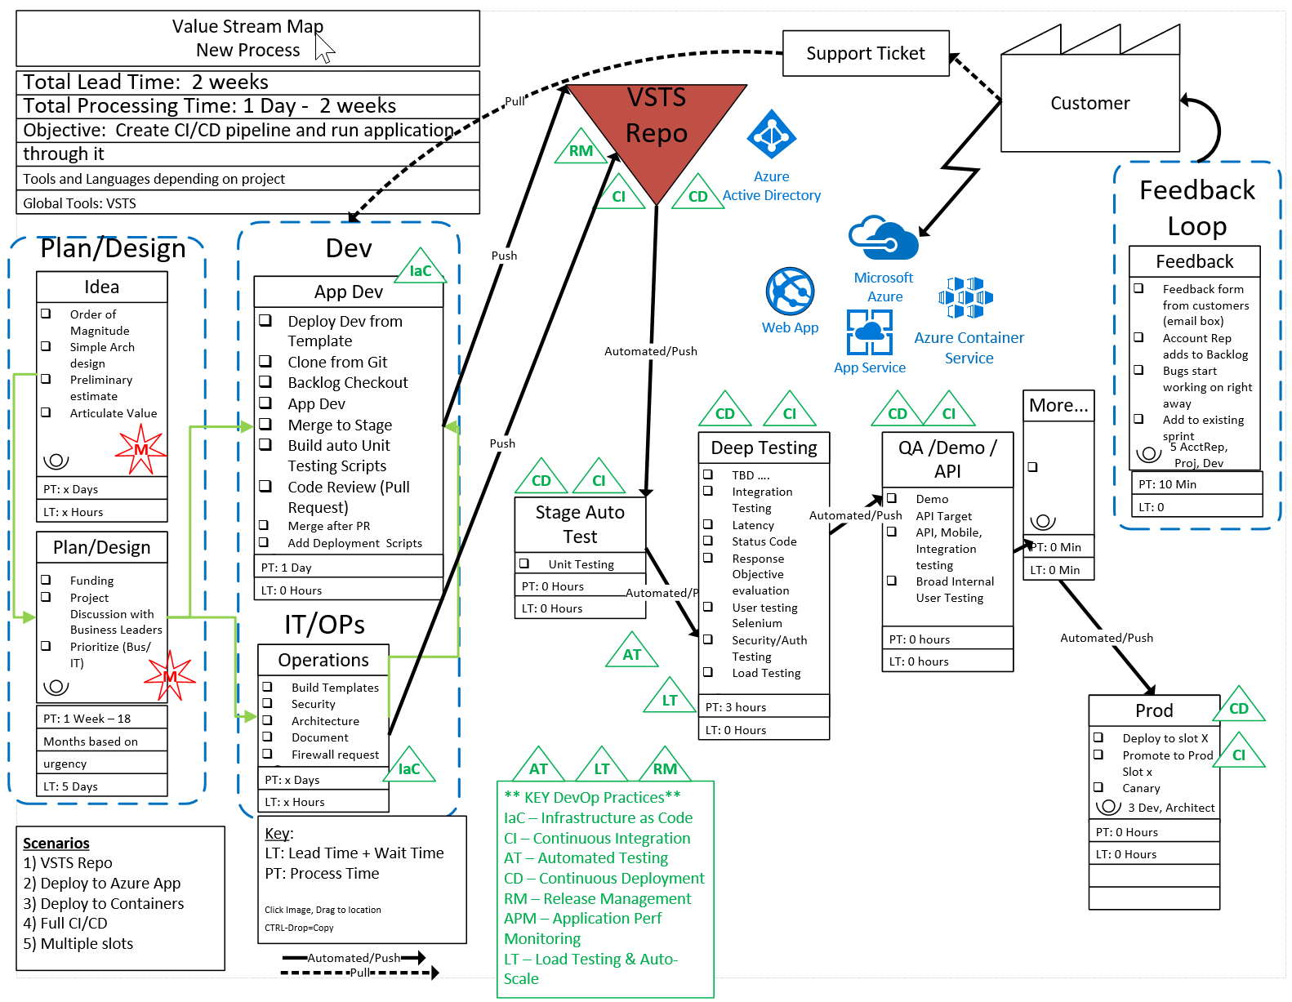
After DevOps & Containers
2 Week Lead time
1 Day – 2 Weeks processing time
Not all waste was cut in first pass
Fully automated and streamlined process with an application flowing through the system.
Investment: 3 weeks

Slide 15
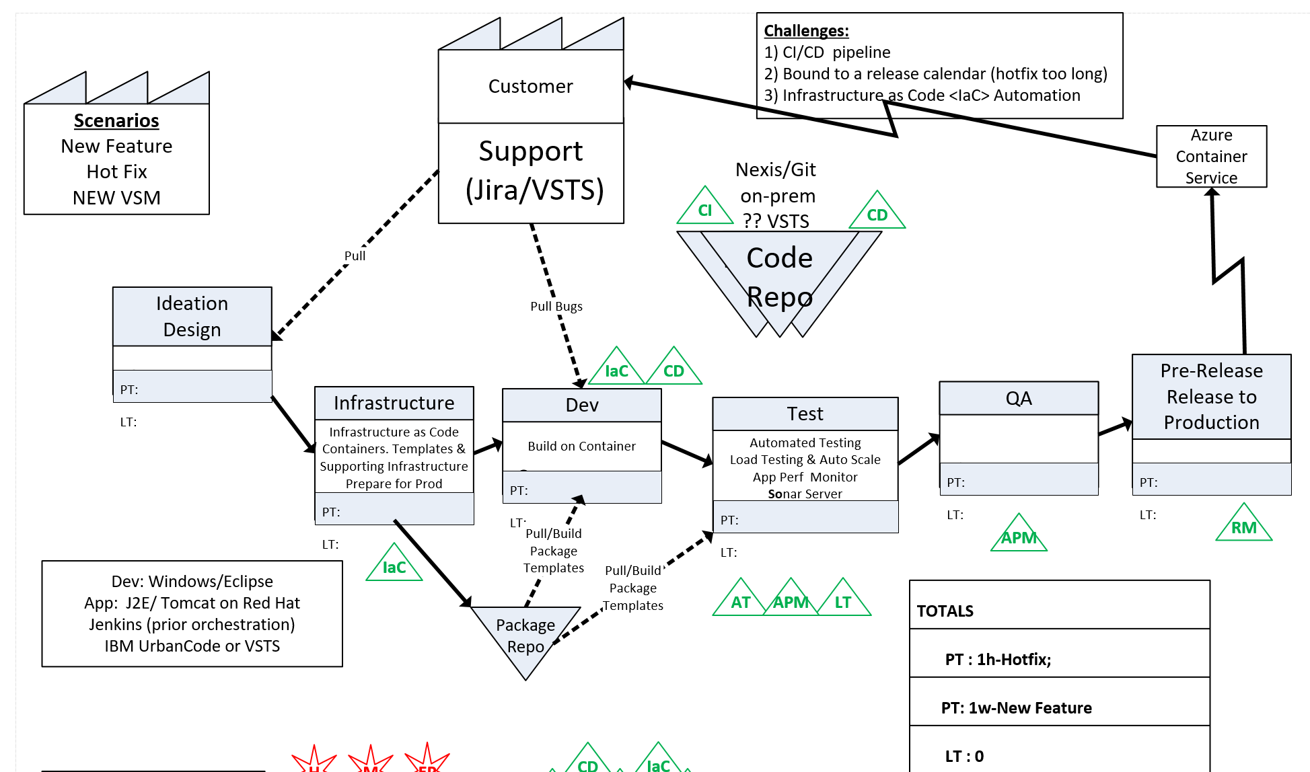
Release Cycle 18 months → 4 weeks Hotfix 6 week → Same Day Investment → 3 weeks

Slide 16
DevOps + Containers Enable Microservices

Slide 17
DevOps & Monolithic vs Micro Services
Micro Services
Split Services into small pieces
Easily Scale, Deploy, code, etc.
Faster Execution
Higher Reliability
Faster MTTR mean time to repair
Agile capabilities
Automation Continuous Delivery
Amplify Feedback Loops
Monolithic
All Feature in Full App
Long Cycles (Dev, Test, Q/A, Deploy, update, etc.)
Error / Bug Prone
Expensive
Quick Fixes hard or impossible
More bottlenecks
Harder to test (more changes at once)
Application
Feature A
Feature C
Feature E
Feature B
Feature D

Slide 18
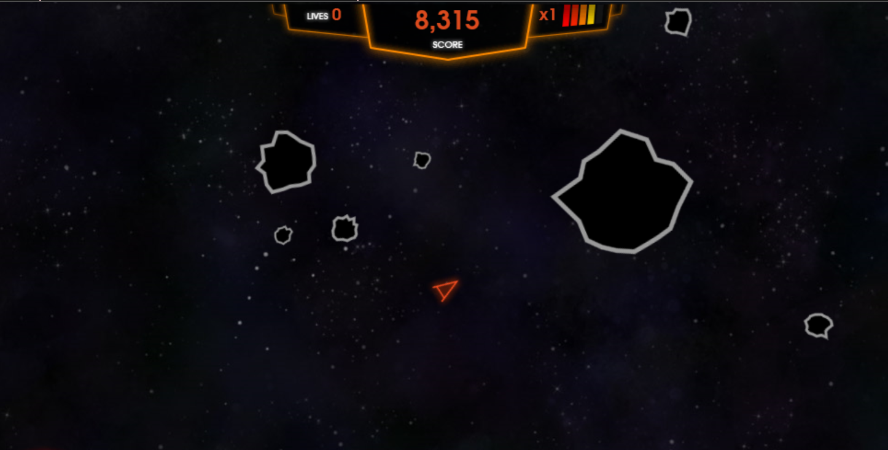
Monolith/Traditional vs Microservices/born in cloud
Asteroids

Slide 19
Labs – Containers http://aka.ms/534Labs Scroll Down to #7 at bottom for containers
Labs: http://aka.ms/534Labs
Azure Portal: http://portal.azure.com
Docs and more Step-By-Step http://docs.microsoft.com

Slide 20
Introduction to containers
App 1
App 2
App 3
Binaries/libraries
Binaries/libraries
Binaries/libraries
Container engine
Operating system
VM
Hardware
Notes:
Describe the concept of containers. Explain their primary purpose and point out the key differences between containers and virtual machines (VMs).
20533D
7: Implementing containers in Azure

Slide 21
Introduction to Docker
Docker terminology:
Image
Container
Dockerfile
Build
Docker toolbox:
Docker client
Docker Engine
Docker Compose
Docker Machine
Docker Registry
Kitematic
Docker Swarm
Notes:
Explain the basic Docker terminology.
20533D
7: Implementing containers in Azure

Slide 22
Implementing Docker hosts in Azure
Install the Docker VM extension:
Use an Azure Resource Manager template, Azure PowerShell, or Azure CLI
Intended for Windows or Linux Azure VMs
Provision a Docker Azure VM from Azure Marketplace:
Intended for Windows or Linux Azure VMs
Run the Docker Machine Azure driver:
Download from docker.com (Windows, Linux, or Mac OS X)
Run docker-machine create --driver azure
Use the --azure image parameter to specify the intended image
Intended for Windows and Linux Azure VMs
Use NuGet provider:
Intended for Windows Azure VMs
Deploy an ACS cluster:
Intended for clusters of Docker Windows or Linux hosts and containers
Notes:
Describe the different methods of implementing Docker hosts in Azure.
20533D
7: Implementing containers in Azure

Slide 23
Deploying containers on Azure VMs
Connect to an Azure VM Docker host:
Docker Machine
RDP
SSH
Use the Docker client to:
Create containers
Stop containers
Remove containers
Create images
Browse for images
Notes:
Describe the different ways to connect to Azure VM Docker hosts. Explain how you can use the Docker client to manage containers. Point out that Azure Container Instances simplifies deployment of individual containers by eliminating the need to explicitly provision the underlying Docker hosts.
20533D
7: Implementing containers in Azure

Slide 24
Demonstration: Installing a Docker host and containers on an Azure VM
install a Docker host and containers on an Azure VM
In this demonstration, you will learn how to
Notes:
Preparation Steps
Make sure to complete the “Prepare the lab environment for the remainder of this module” demonstration.
Demonstration Steps
Follow the instructions provided in https://aka.ms/qu1kh3. When running docker-machine to provision an Azure VM, include the --azure-resource-group parameter and set its value to 20533D0701-DemoRG.
20533D
7: Implementing containers in Azure

Slide 25
Creating multicontainer applications with Docker Compose
Install Docker Compose:
Included by default when using:
Azure Marketplace Docker images
The Azure VM Docker extension
Docker Machine
Create docker-compose.yml:
Include all containers
Specify container dependencies
Specify deployment parameters
Run docker-compose up
Notes:
Describe the process of implementing multicontainer applications by using Docker Compose.
20533D
7: Implementing containers in Azure

Slide 26
Implementing Azure Container Registry
Create the Azure Container Registry service:
Classic:
Requires a separate storage account
Configurable via the Azure portal
Managed: Basic, Standard, and Premium
Configurable via the Azure portal and Azure CLI
Use the Azure Container Registry service:
docker login
docker pull
docker tag
docker push
docker pull or docker run
Notes:
Describe the two types of Azure Container Registry services–classic and managed–and explain the differences between them. Point out that there are two authentication and authorization methods, but emphasize that students should use the Admin user method only for single-user scenarios.
Describe the steps to upload and download images when using Container Registry.
20533D
7: Implementing containers in Azure

Slide 27
Implementing ACS
Overview of container-clustering solutions in Azure Creating and managing an ACS Docker Swarm cluster Creating and managing an AKS Kubernetes cluster Creating and managing an ACS DC/OS cluster Demonstration: Creating an ACS DC/OS cluster
Notes:
Question
What are the primary characteristics of Docker Swarm–based ACS deployments?
( ) Option 1: Support for Docker APIs
( ) Option 2: YAML-based container deployments
( ) Option 3: Cluster management via a web-based interface
( ) Option 4: Cluster management via a command-line interface
( ) Option 5: Requirement to create an Azure AD service principal
Answer
( √) Option 1: Support for Docker APIs
( ) Option 2: YAML-based container deployments
( ) Option 3: Cluster management via a web-based interface
( √) Option 4: Cluster management via a command-line interface
( ) Option 5: Requirement to create an Azure AD service principal
Feedback
Docker Swarm–based ACS deployments offer full support for Docker APIs, including management via Docker client command-line tools. YAML-based container deployments are part of Kubernetes and DC/OS-based container clustering. An Azure AD service principal is necessary when deploying Kubernetes-based clusters.
20533D
7: Implementing containers in Azure

Slide 28
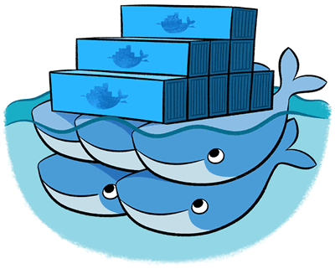
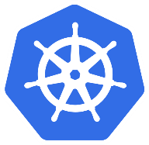

Overview of container-clustering solutions in Azure
Notes:
Explain the primary differences and similarities between the three orchestrators available when deploying ACS clusters.
20533D
7: Implementing containers in Azure

Slide 29
Creating and managing an ACS Docker Swarm cluster
Create a Docker Swarm cluster in ACS:
Requires an SSH RSA key
Specify the master and agent counts
Specify the agent VM size
Connect to the Docker Swarm cluster:
Establish an SSH tunnel to the master FQDN
Set DOCKER_HOST to 172.16.0.5:2375
Deploy containers to the Docker Swarm cluster:
Use docker run for individual containers
Use docker-compose for multicontainer applications
Notes:
Describe the process of deploying Docker Swarm–based ACS clusters and deploying containers in them.
20533D
7: Implementing containers in Azure

Slide 30
Creating and managing an ACS Kubernetes cluster
Create a Kubernetes cluster in ACS:
Requires an SSH RSA key
Requires an Azure AD service principal with the Contributor role to cluster resources
Specify the number of master and agent nodes
Specify the agent VM size
Connect to the Kubernetes cluster:
Install kubectl
Authenticate via SSH and download Kubernetes credentials
Deploy containers to the Kubernetes cluster:
Create a YAML-formatted manifest file
Run kubectl create and reference the manifest file name
Notes:
Describe the process of deploying Kubernetes-based ACS clusters and deploying containers in them.
20533D
7: Implementing containers in Azure

Slide 31
Creating and managing an ACS DC/OS cluster
Create a DC/OS cluster in ACS:
Requires an SSH RSA key
Specify the number of master and agent nodes
Specify the agent VM size
Connect to the DC/OS cluster:
Establish an SSH tunnel
Connect to the DC/OS web portal via http://localhost
Install DC/OS CLI
Deploy containers to the DC/OS cluster:
Create a YAML-formatted Marathon configuration file
Run dcos marathon app add and reference the file name
Notes:
Describe the process of deploying Datacenter Operating System (DC/OS)–based ACS clusters and deploying containers in them.
20533D
7: Implementing containers in Azure

Slide 32
Tips, Tricks and Field Experiences
Recognize Accomplishments
Finish a chapter, Finish a Lab, Watch a video, Read a white paper… All Accomplishments
Get Family On Board
Make your goals, their goals. Trip to Dave & Busters upon completion, ice cream shop for a chapter
Make the Decision… Get STARTED NOW!
Self, Career, Income, Stature
Value of Certification
Excuses
Excuses are Easy; Results are forever! Just Do IT!
Value of time
What is your time worth? When you are sitting in front of the tube, that is what it is costing you
Notes:
Tips, Tricks and Field Experiences Value of Certification: I want to make sure you are on board with the value of certification. Certification can offer many advantages including: getting a raise at your next review, preparing you for new job opportunities, increasing the likelihood your resume will be seen by the hiring manager, increasing your self confidence, increase you image (how people see you) in your business and in your social circles, lines on your resume, most hiring managers consider certification as part of their hiring criteria, you get experience while preparing for certification,…. and the list could go on and on. The fact of the matter is there is never any shortage of reasons why we should get certified. I am glad you have read this far… Make the decision to read this article in it’s entirety, then GET STARTED!!! Write down the reasons you want to obtain certification and look at them daily. Recognize Accomplishments: Recognize your accomplishments not matter how small. Feel good about the fact that you finished reading this article and realize that having done so has gotten you one step closer to obtaining your MCP in the Azure Cloud. Each time you finish something, even if it is just watching a 20 min video or reading a blog post that is relevant to the exam, recognize to yourself that it is a positive step in the right direction. Reflect back on why you want to do this in the first place. Get Family On Board: Often having family (spouse, kids, etc) on board with your goals and objectives will help you stay the course. Engage them, offer the kids a night out at Dave & Busters or an ice cream shop once you pass the exam. Show them your great study habits, maybe they will pick some of them up for their school studies. Excuses: Excuses for not getting certified are easy to come by… I do not have time, can’t concentrate because of the kids, tired when home from work, my boss does not care anyway, it will not help me in my job… and on and on… Give it up! Stop making excuses; stop procrastinating and make the decision to put your career in motion! Keep doing what you have been doing, and you will keep getting what you have always gotten. Value of time: Put a value on your time. What is your time worth? When I was a consultant billing out $250 an hour, that was the value I had on my time. Now it is often somewhat less. Now, during my busy season, I use a value of $100 per hour. During my slow season, when I am much less stressed and work fewer hours, I use a value of $50 per hour. During the summer, family time, the value shoots back up to $250. This may seam silly but it will help you prioritize your time. It will also help you justify purchases. When you consider purchasing a $40 book it will be a no brainer. Spending $40 will potentially save you dozens of hours of time because you will be studying exactly what you need to know, nothing more, nothing less. It may help you decide you should just be taking a class to get this behind you quickly. Even if you just use a value of $10 per hour, it is important to pick a value for your time! If you are broke and have a zero value for your time, fake it. Put a value on your time anyway it will help you prioritize. Even if it is only $1, is sitting in front of the tube watching a sitcom by yourself worth a dollar? Not usually, get up and pick up a book or watch a certification video instead! Dedicated Study time: Set time on the calendar every day or every week for preparation. Just like any other appointment, take the attitude that you have to be there at the scheduled time to perform the duties that are expected of you. Blocking the time on the calendar then sticking to it is likely the single best thing you can do to help you succeed. Figure out what works best for you. Maybe it is 30 mins every day at lunch? How about 45 hour every night from 8:15pm-9:00pm? Whatever time block works for you is great. Personally, I find the best time for me is in the morning before work. This is when I am the most alert and can absorb the most information. I tend to get into the office before others, so I leverage the quite time as my personal development time. Try it, go into the office 45 minutes early to see if that works for you. You have to stick with it though, if you do it once and get distracted, don’t give up, try it a few more times. If people bug you, put a sign up letting them know you will be available for questions at 9:00am or whatever time you actually start working. Personally, when I am cramming, I will often spend 3-4 hours a day. I suffer from insomnia so I have plenty of extra time in my day. I prioritize that time on preparation. Ultra Focus With Intent: When you sit down to study, don’t take it lightly. Stay hyper-focused on learning. Don’t let your mind wander. You are on a very important mission. That mission is to learn as rapidly as possible. If you do this you will find that you will retain far more information and you will be able to consume it much faster. Read Faster: You can read faster. Use your ultra focus, it is a must to achieve this one. While reading, move your finger across the page or the screen at a steady pace, do not stop your finger, make sure your eyes focus on the word over your finger. It is ok if you miss a word or two, DO NOT GO BACK! Then when you master that move your finger faster, then faster, then faster. Eventually, you will be able to do this without the use of your finger as an aid. Objective: Recognize your objective when you set out to take an exam. The objective should be to “Pass the Exam”. Kind of self explanatory right? Not… Some people think, and will tell you that you have to learn everything about the topic in order to pass the exam. Total crap! Learn what you have to learn to pass the test, then leverage that knowledge to learn more as you progress your career. Study Smart: I have studied for many exams and hold more certifications than I can put in my signature block. What I have found in preparing for all the exams I have taken is “it is easy to study the wrong thing”. You know, you go to a blog post or a white paper to get information about an exam and they are telling you to read some 380 page document or white paper. That is bogus, don’t waste you time. I would guess that if you did read that document, you may learn more and maybe get one or two more questions right. But at what cost? Better to cover the materials on the test than, everything there is to know about a topic. More on this later! Objective: Recognize your objective when you set out to take an exam. The objective should be to “Pass the Exam”. Kind of self explanatory right? Not… Some people think, and will tell you that you have to learn everything about the topic in order to pass the exam. Total crap! Learn what you have to learn to pass the test, then leverage that knowledge to learn more as you progress your career. Exam Reference Material: There is often plenty of exam reference material available. Often it is even free. I will point you to some of it later in this article. If you do not mind spending a bit of money, I strongly recommend you just start with an exam reference guide. This could be much faster than spending countless hours learning what may or may not be on the exam. I am personally not a fan of just studying exam questions. I do find them useful, I just find having more context around the topic helps me retain it. by all means, try the practice tests, they be be helpful for you. Practice & Experience: There is no substitute for practice other than maybe experience! Use the technology you are trying to learn. If you have the ability to use the technology in your job, even better! Take advantage of these opportunities. If the opportunities are not there, go out of your way to make opportunities. Think about how you might be able to use this technology in your job, then justify to yourself why it is important to understand the technology for your job. Most employers want their staff IT staff to keep up with technology. They often also will accept that you do it partially on work time. Especially if they know you are spending a bunch of personal time learning. Even if it is just setting up a lab environment, getting your hands dirty will go a very long way to you understanding the technology. Exam Objectives: Most exams (and all of Microsoft exams) have well documented Exam Objectives or Skills Measured. Use the Exam Objectives as a “list of things to learn”. Print out the exam objectives and check them off one at a time, as you search that topic and spend time learning it. For the cloud exam, I have done much of the work for you, you can just print this blog post. Like writing a book: I am in the process of writing a book on a certification exam. When writing a book on a topic, you do not automatically know everything there is to know about that topic. You are generally not in a situation where you know it all and want to write a book to share your vast knowledge on the subject. On the contrary, you may know a bunch about the topic, but to teach people everything they need to know to pass the test, you have to learn much, much more. The way I do this is using the Exam Objectives. I research & learn what I can on each exam objectives, teaching and writing as I go. One of the other things you do prior to writing a book is, take the test. Take the test: Take the test, get a feel for what is on it. Microsoft offers a “2nd shot” so you can take the test a second time for free. Once you have gone through all of the exam objectives one time quickly, take the test to see how you do. This will give you a report so you can see what you need to study. As you are studying you will remember exam questions so you will know the relevance. After you pass the exam, if you want to learn more, use the exam report to study the things you did not ace (if you are so inclined.) What Exam: Figuring out what is the best exam to take next is often a challenge. Really though, it does not matter. See https://www.microsoft.com/learning whichever exam you chose will likely prepare you for what is next in your professional life because getting certified will make you better at it! If you are a general or specialized IT person start with 70-533. If you are a developer, start with 70-532. If you are an architect or infrastructure designer start with 70-534. If you are not sure, start with 70-533. Whatever you do, just start NOW! Once you pass the first cloud exam, go back and study the next one. Then repeat until you have passed them all. By then you should have caught the bug (the high that comes with a great accomplishment) and you will pick another topic and repeat! - See more at: http://itproguru.com/expert/2015/03/azure-cloud-certification-jump-start-70-532-70-533-70-534-exam-preparation/#sthash.sDikFZa4.dpuf

Slide 33
Tips, Tricks and Field Experiences
Practice & Experience
NO SUBSTITUTE! Do the labs; Azure @ Work
Take the test
2nd shot? Much easier after you take it because you know where you are weak ☺
Ultra Focus With Intent
After you pass the test, you can work on learning more and developing your career
Objective – Pass the Exam!
Don’t let your mind wander; You are on a mission to learn FAST!
Excuses
Excuses are Easy; Results are forever! Just Do IT!
Dedicated Study time
30 mins Day/night Pick a time; make it happen!
Read Faster
DO NOT GO BACK!
Use your finger, keep it moving make eyes follow

